Slide 1

Presenting By: Tasmiya Mansoor
Stream: Automation Testing
Employee ID: 13048
Automation Testing Stream

Slide 2
CONTENTS
Manual Testing
Automation Testing
JMeter
Big Picture
Reference links
Automation Testing Stream

Slide 3
1. Manual Testing
Swag labs demo site: https://www.saucedemo.com/
By referring the given User stories created Test plan.
Created Test scenario and test cases .
Executed the test cases and made documentation.
Jira created project called Swag labs and added Version, Epic, User stories, Sprint, imported test cases, created Cycle summary then executed the test cases manually and update the result in Jira along with the documentation.
Raised defect in Jira and created Defect sheet and RTM.
Automation Testing Stream

Slide 4
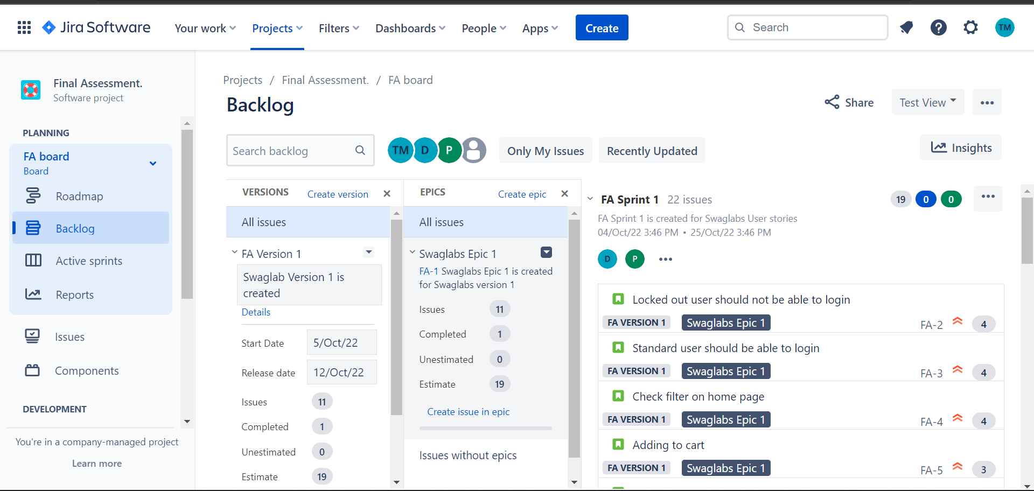
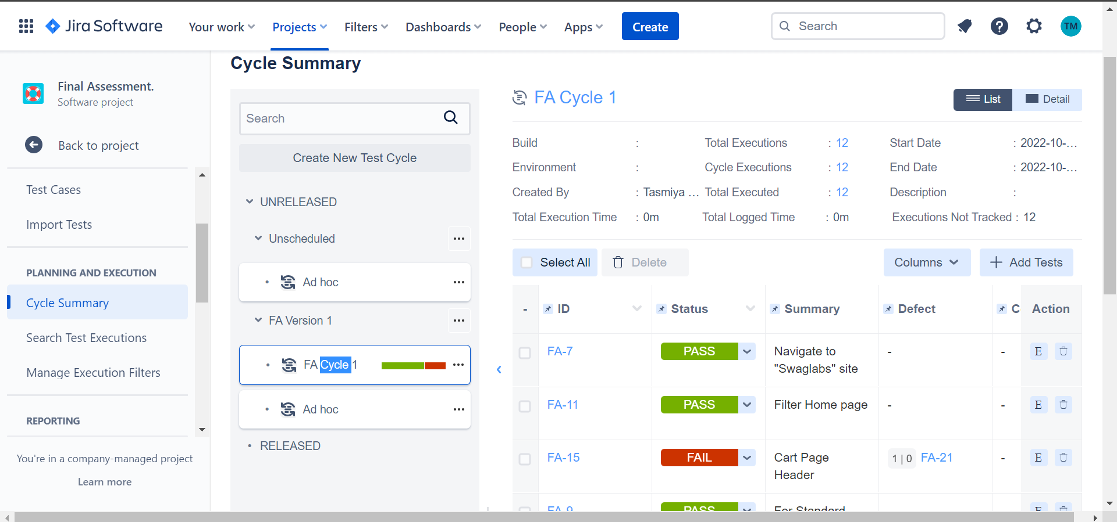
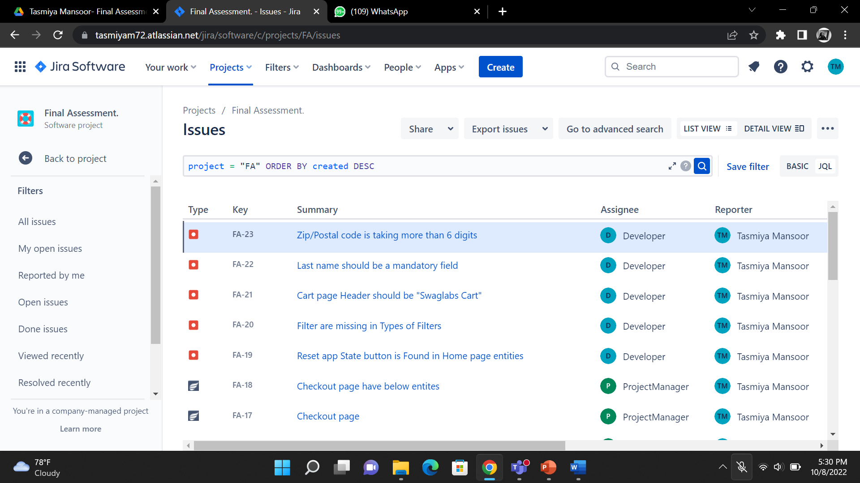

Slide 5
2. Automation Testing using Java Selenium
Automated the Login and Dashboard elements using different Locators of Orange HRM website. https://opensource-demo.orangehrmlive.com/web/index.php/auth/login
Performed the different Mouse actions
https://jqueryui.com/
http://demo.guru99.com/test/newtours/
http://www.aptransport.org/
Performed Alert Handling on below website. https://the-internet.herokuapp.com/javascript_alerts
Wrote a program to HRM Login, apply leave and Searching employee using method overloading in TestNG Framework.
Object Oriented Programming: Wrote programs on these topics: Override, Overloading, Inheritance, Abstract, Interface, Exception Handling, Collections, Access Modifiers.
Wrote a program to HRM Login, apply leave and Searching employee in Cucumber.
Automation Testing Stream

Slide 6
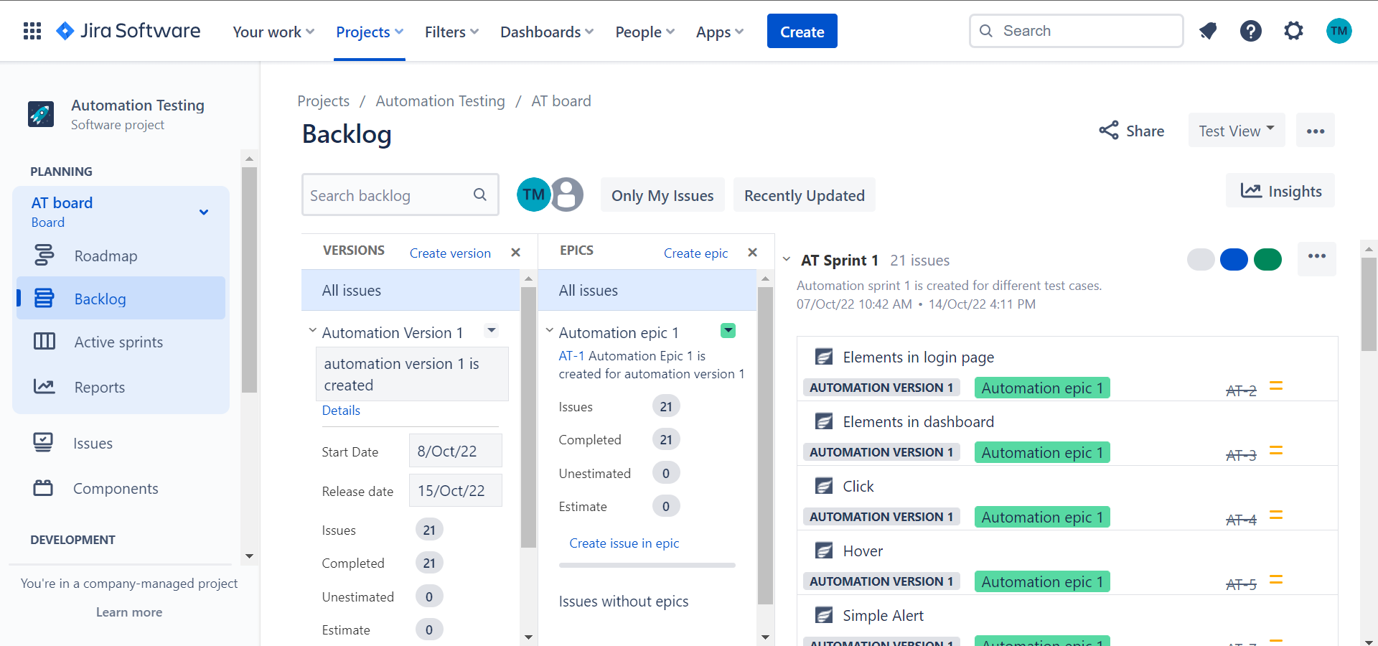
Automation test cases in Jira.

Slide 7
3. Performance Testing - JMETER
Performed 2 rounds of load testing with 25 users, on OrangeHrm application using JMETER.
Automation Testing Stream

Slide 8
5. Big Picture
Created a big picture based on my understanding of complete testing concepts
Automation Testing Stream

Slide 9
Reference Links
Drive
https://drive.google.com/drive/folders/1tBX7b5OD1pwmEJnL81NAiHbHMQOy7oT?usp=sharing
Blog
https://medium.com/@tasmiyam72
GitHub
https://github.com/tasmiya7227/finalassessment.git
Jira
https://tasmiyam72.atlassian.net/jira/your-work
Automation Testing Stream

Slide 10
THANK YOU
Automation Testing Stream

